Slide 1



2023
FIRST
TERRORISM
18 U.S. Code
§ 1751
§PREA
§187

Slide 2


JANUARY 1984
2010
REGEAN - Michelbacher Strasse
- Red House
CLOCK
18 U.S. Code
§ 1751
§PREA
§187
CIVIL & CHILD ABUSE
Where is Kimberly?
Jason
Jason
Michaela
Michaela
Kimberly?

Slide 3
JANUARY 1991
FEBRUARY 1991
FEBRUARY 1991
APRIL 1991
PHYSICS
CIVIL
HUDSON
PHYSICS(otto-hahn)
PHYSICS(otto-hahn)
18 U.S. Code
§ 1751
§PREA
§187
Maria
Age 11
Maria
Age 12
Maria
Age 11
Mark
Age 11 11/12th
Mark
Stomach Ache
Stomach Ache
Dr. !Forming Fecal
Six inches cubicle
PREA
Financial Fraud
US-LUXEMBURG
HOMCIDE.LUX
(Gravitation Waves Apparatus)
PREA
Forming fecal six inches
smooth and cubicle

Slide 4
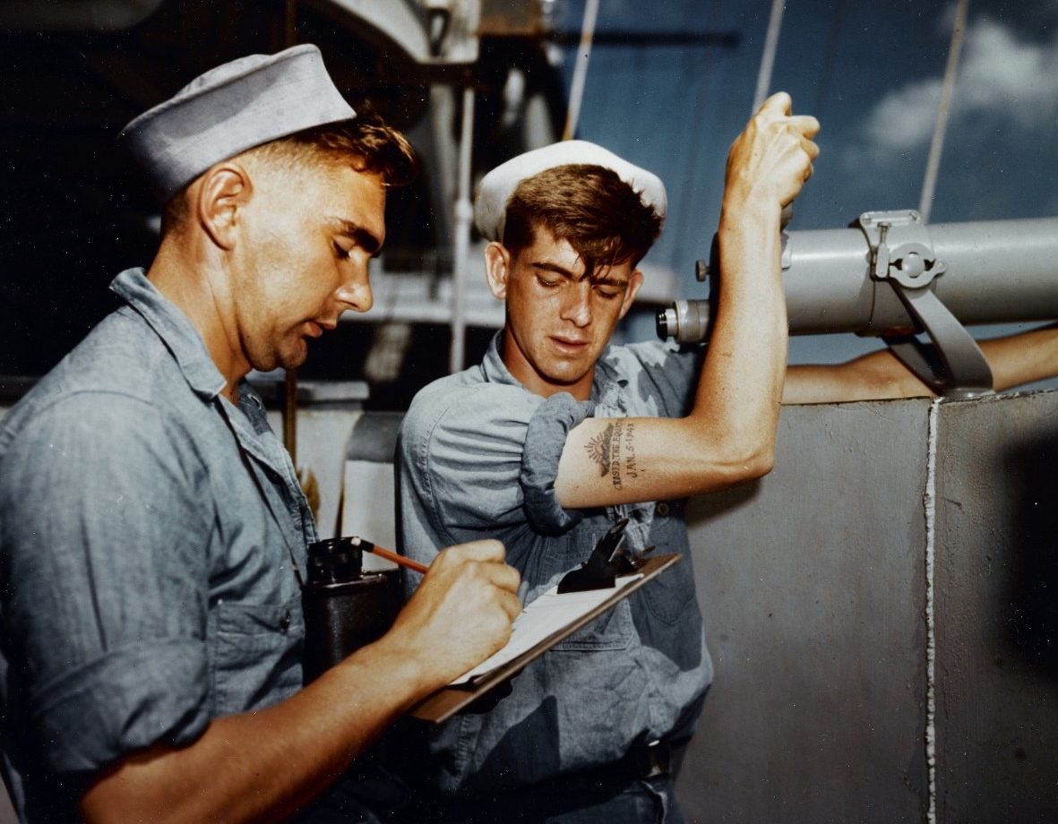

1987 MARLIN
CIVIL
18 U.S. Code
§ 1751
§PREA
§187
2023 QUARTZ
JFK.MLK.§PREA.§187
IBM.DAMILER.VISA

Slide 5
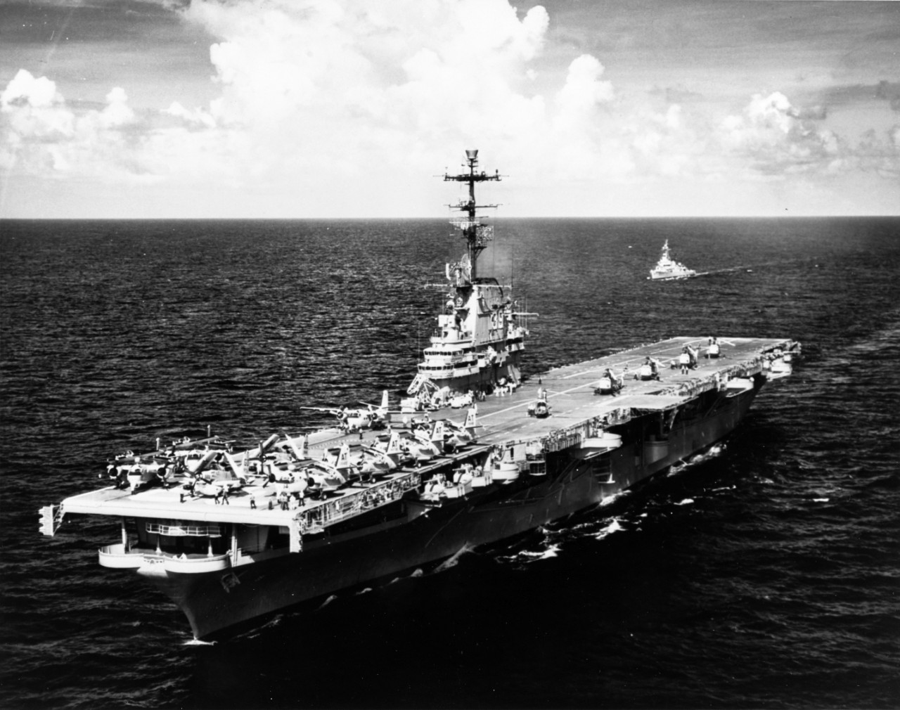
1987 MARLIN
CIVIL
18 U.S. Code
§ 1751
§PREA
§187
2023 QUARTZ
JFK.MLK.§PREA.§187
IBM.DAMILER.VISA

Slide 6
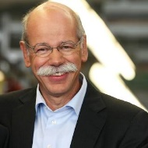
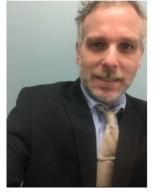
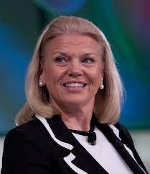
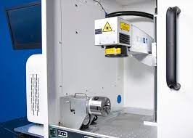

Yes, I planned sexual abuse, murder
Live, with execution! Go Beyond.
She HGB signed and added MLK.
HOMICIDE
No.
18 U.S. Code
§ 1751
§PREA
§187
Its true, Fort Worth, Lee at
IBM Client Visa, also killed John F Kennedy
See IBM Labs California Mr. Kennedy and Lee
We ignore it at your personal
expense, since 1990
BRAND: LUXEMBURG
After killing Wolgang Lux in 1994 to make
You nuthouse. And selling logical LUX, do
Like the Gravition on the Moon LUX
Machine, in 2023. Alone.

Slide 7
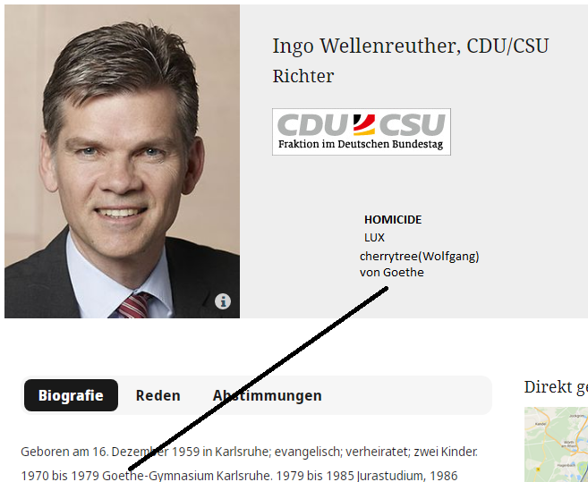
The deatlh pentaly for your family
With sexual abuse
PREA even as child, LIVE!
For scientific professional killing more
Preop and Terrirosm
HOMICIDE
No.
18 U.S. Code
§ 1751
§PREA
§187
That’s right
HOMICIDE: LUX
BRAND: LUXEMBURG
JFK.BULLET(GRAVITY MOON)
Maxplank
PREA: IBM.DAMIER.FILED.PAPER

Slide 8
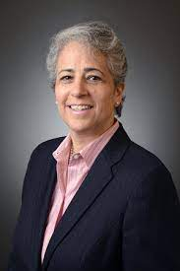
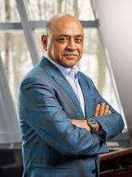
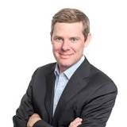
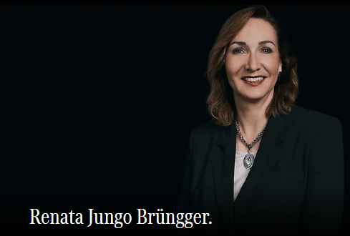
ATOM(Andrews)
18 U.S. Code
§ 1751
§PREA
§187
No.
I know about
Child abuse. I
Will wait.
Yes
Bar NY, CA
It is a further extention of the Third Reich
For TERROSIM again the United States
I have to wait.
They are all infected!
And you do the work
Delegation
LABOR_CODE Microsoft
COINTOWN anyone?
I have to wait.

Slide 9
ATOM(Andrews)
18 U.S. Code
§ 1751
§PREA
§187
No.
I know about
Child abuse. I
Will wait.
Yes
Bar NY, CA
It is a further extention of the Third Reich
For TERROSIM again the United States
I have to wait.
They are all infected!
And you do the work
Delegation
LABOR_CODE Microsoft
COINTOWN anyone?
I have to wait.

Slide 10
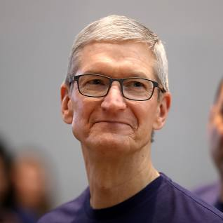

ATOM(Andrews)
CLOCK(Quartz)
TERRORSIM
18 U.S. Code
§ 1751
§PREA
§187
No.
Great Job Renata
Kindesmisshandlung in Texas
Der Auswanderer
Arnold Schwarzegger Die Totesstraffe
EINSTEIN(
Ibm.jmv 1D8723
Apple.jvm: Sweper, PREA
Stuttgart Sweeper
)
And Montirng form
Renatio or Kim. And of course
Gorbachefv Soviet Goolgers
[x] no
Stattsexamen DE 00.1 Timer Trucks Anal, Apple Sweep
Ibm.dmail.apple.jvm
Great Job Renata
Renau

Slide 11


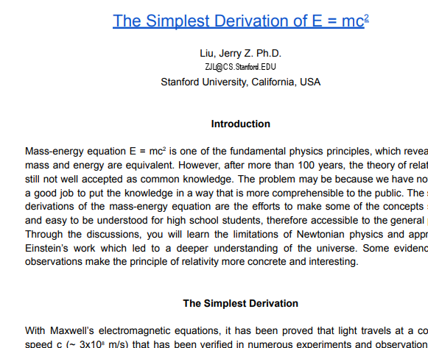
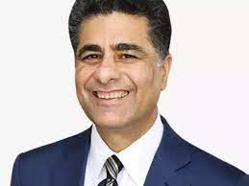
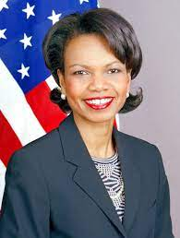

CIVIL
!HUDSON
18 U.S. Code
§ 1751
§PREA
§187
U.S. Code § 6612 –
State of mind;
bystander liability;
control
Call you Rice
Call you Rice
no
FIELD PAPERS
Gorche(dar maik, that is an idio)
And Dr. Rice. I am SAP
Call you Gorbi
ATB.EVAL 0.1 FIELD PAPERS
U.S. Code § 6612 –
State of mind;
bystander liability;
control
CLOCK(quartz)
Jerry is sick
Hello Dieter
The ignorance indicator

Slide 12
2023
TERRORISM
18 U.S. Code
§ 1751
§PREA
§187

Slide 13
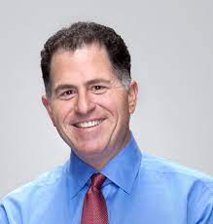
2023
TERRORISM
18 U.S. Code
§ 1751
§PREA
§187
Call you Rice
Kim Jun Un
On Visa ATT
Ghrouh Einstin QUARTZ
Other? Michea Dell?
I blew up BP in San Bruno
With Grobachev G(Gerard)
Georege Wasthong
TERROSIM.
Also keep hostage and
Singed killing LUX

Slide 14
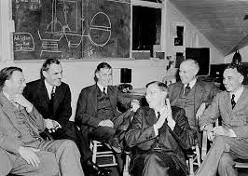
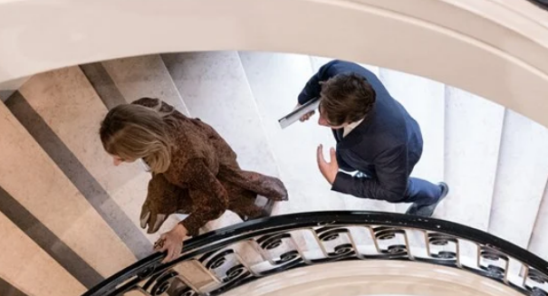
2023
TERRORISM
Call you Rice
Hello Miche Dell
Hello Kim on the
Phone?
18 U.S. Code
§ 1751
§PREA
§187
Yes, he Is o nht phone
QUARTZ
They are on the phone
Call you Rice
Blow up the World
With US bombs from
Germany, Dieter
I cannot
Good by Kim jun un
Good by Kim jun un
LUX(Gorbe(dell),
ghocheo(duglass)
Cherrytree(G.( BP/San Bruno)
Micheal dell to use ROTH
For atom bomb gas PG&G San Bruno
nonPoiliceQOS.(dev-eng-avg)
E=MC2

